Slide 1
SI184 Evolución del Software
GUÍA BÁSICA DE SCM PARA EL PROYECTO

Slide 2
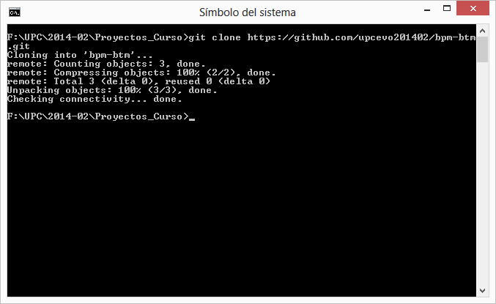
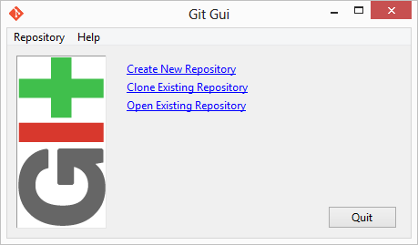
Clonar inicialmente el repositorio

Slide 3
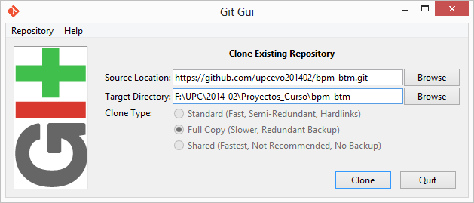

Slide 4
NO haga lo siguiente
commit anything that can be regenerated from other things that were committed.
commit configuration files.
use git as a web deployment tool.
commit large binary files (when possible).
create very large repositories (when possible).
use reset (--hard || -merge) without committing/stashing
use checkout in file mode

Slide 5
NO haga lo siguiente
use git clean without previously running with "-n" first
prune the reflog
expire "now“
use git repack –ad
use a branch argument to git pull or git fetch
use git as a generic filesystem backup tool
rewrite public history
change where a tag points

Slide 6
NO haga lo siguiente
use git-filter-branch
create --orphan branches
use clone --shared or –reference
use git-grafts
use git-replace

